Slide 1
Shell Bootcamp 2024 Learning from Technical Training
Mahendra Kumar
Date : 30-Aug-2024

Slide 2

About Me
Dedication for improvement is what makes you perfect.

Slide 3

My learnings from this week!

Slide 4

Week 1 | My takeaways
Key Learnings
Requirement Analysis
Management Techniques and Models
SDLC using AGILE methodology.
Key takeaway
Functional and Non-functional Requirements.
Scenario, Class and Data based Models.
Scrum sprint following AGILE methodology.

Slide 5
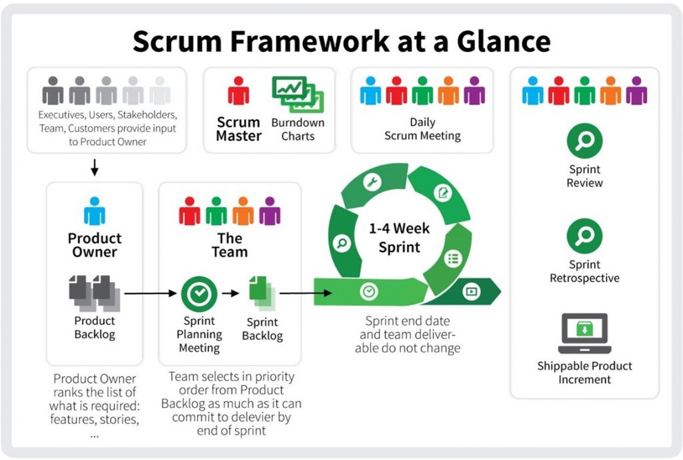
Week 1 | My takeaways
How do I personally see this concept implemented in the Energy sector
Management models in the energy sector are crucial for optimizing resources, reducing costs, and enhancing sustainability. They enable efficient decision-making, risk management, and alignment with regulatory standards.
The Scrum AGILE methodology is vital in the energy sector for enhancing project efficiency, adaptability, and collaboration. Scrum helps manage complex project, from renewable energy deployments to infrastructure upgrades, ensuring timely and cost-effective outcomes.

Slide 6
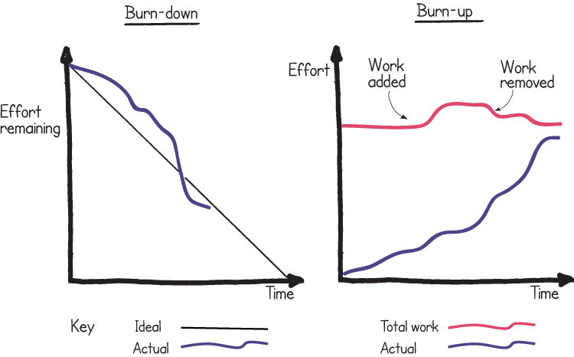
Week 1 | My takeaways
KANBAN
The Kanban method is an approach to evolutionary and incremental systems and process change for organizations.
Story Pointing (Ready-Spint-Done)
Definition of Ready(DoR)
Definition of Done(DoD)
Estimation in Agile (Scope, Team, Cost)
Customer Ready Stats
Team Estimates
Team Discuss

Slide 7

Week 1 | Relevance for Shell
How I feel Shell implements this learning:
Cross-Functional Teams
Daily Stand-Ups
Sprint Reviews and Retrospectives
WIP Limits
Relative Estimation
How I feel Shell benefits from this learning:
Improved Efficiency
Enhanced Flexibility
Increased Transparency

Slide 8
Week 1 | Challenge faced while implementing
Challenge faced while implementing:
Consistency in Story pointing
Implementation Delays
Maintaining Discipline
Challenge faced while implementing:
Adoption of agile suddenly
Training and Expertise
Integration with my existing knowledge
Continuous adaption

Slide 9
Thank You

